Slide 2
Calculus for ML

Slide 3
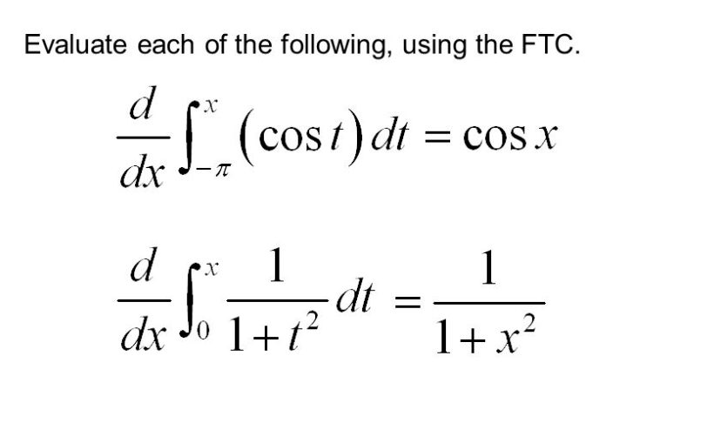
Fundamental theorem of Calculus

Slide 4
Fundamental theorem of Calculus
https://youtu.be/WUvTyaaNkzM

Slide 5
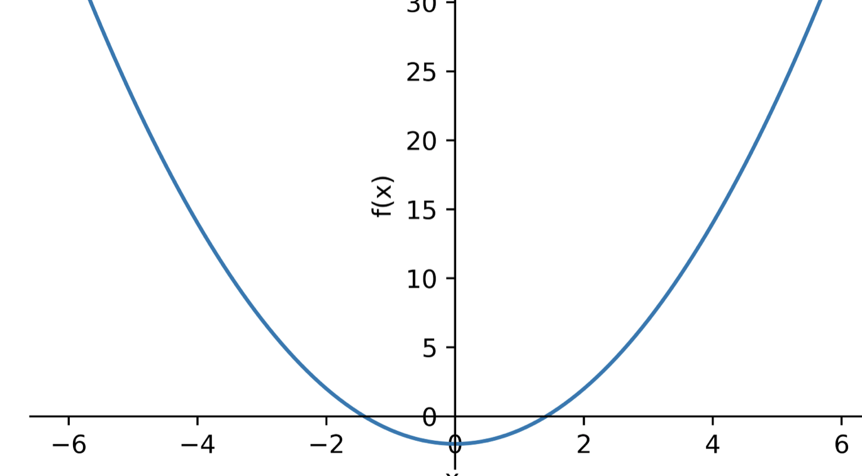
Newton Raphson method

Slide 6
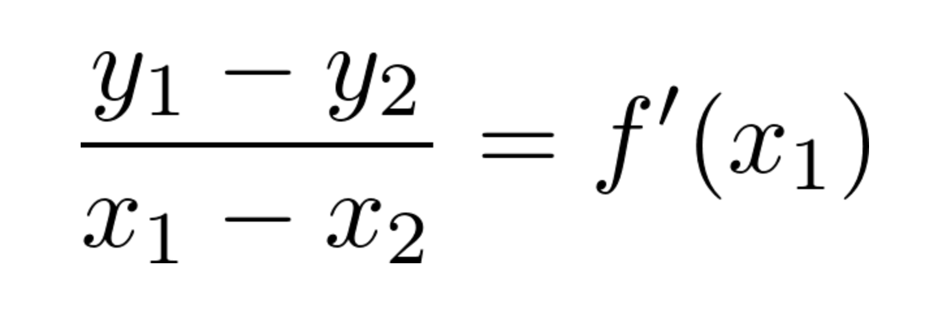
Slope

Slide 7
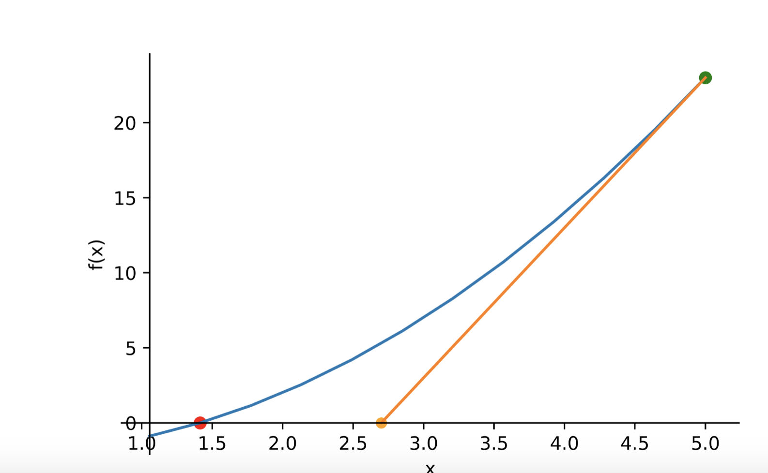
NEWTON RAPHSON METHOD

Slide 8
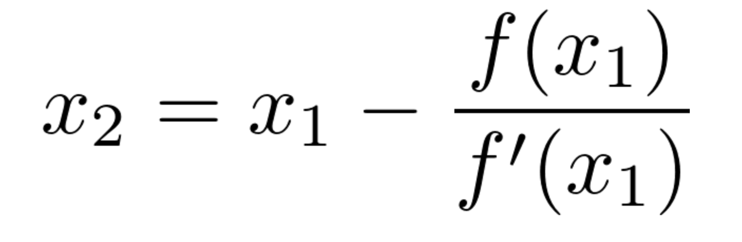
Newton Raphson Formula

Slide 9
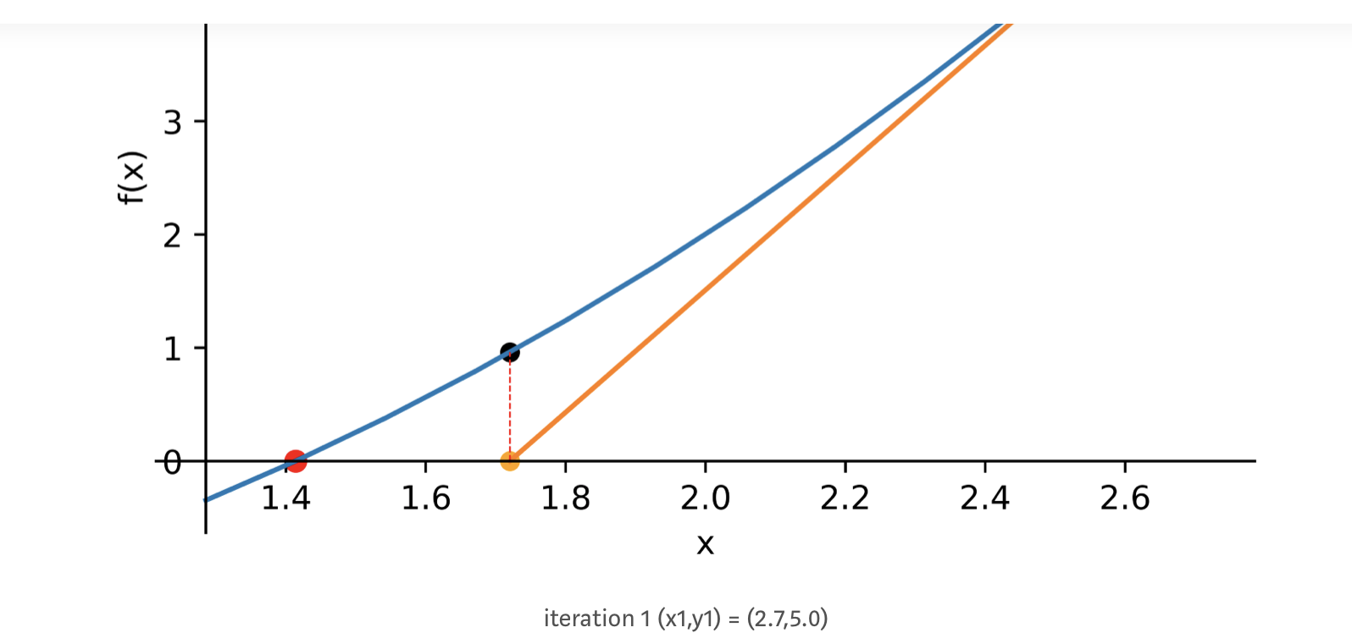
Newton Raphson iteration 1

Slide 10
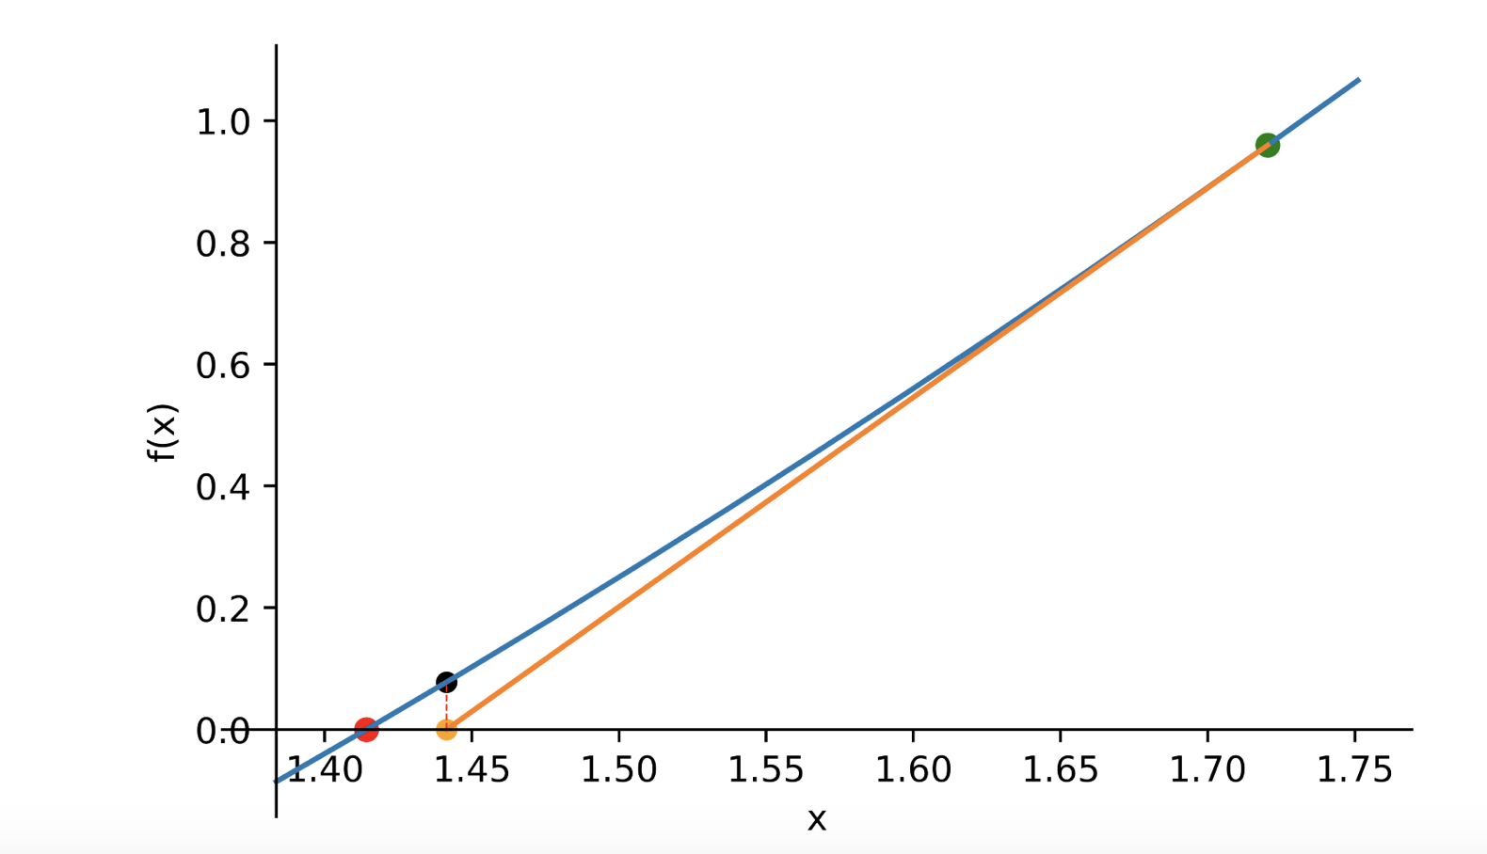
Newton Raphson iteration 2

Slide 11
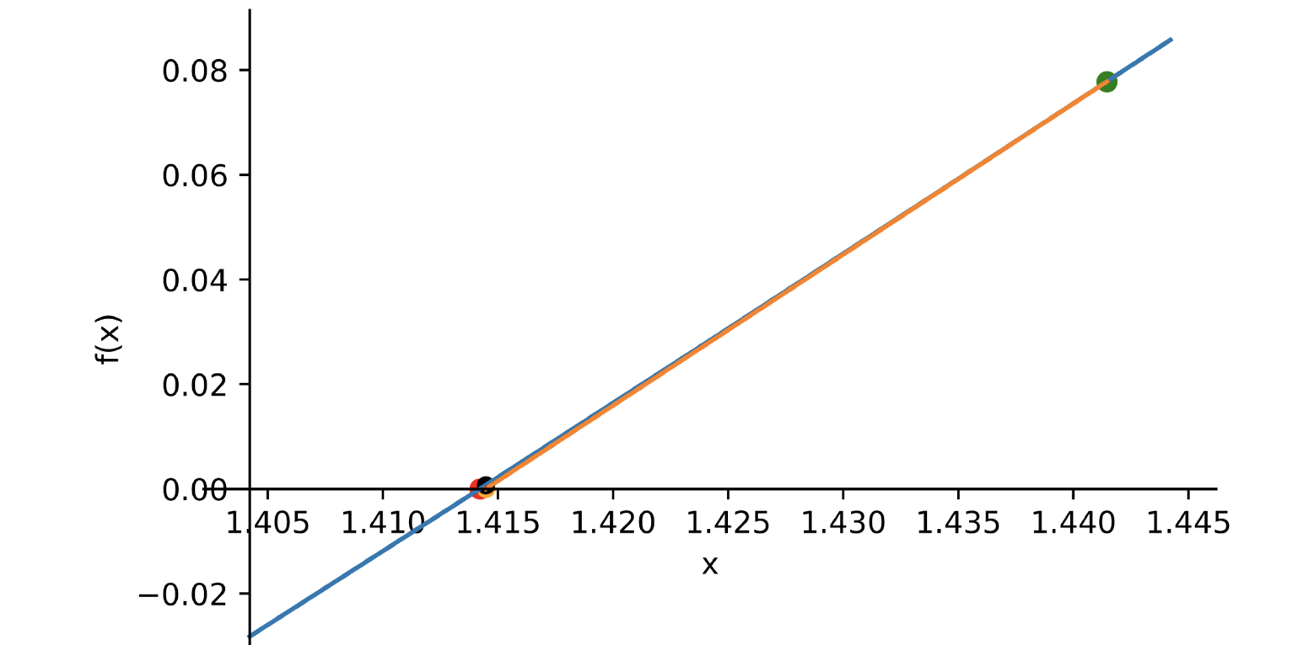
Newton Raphson iteration 3

Slide 12
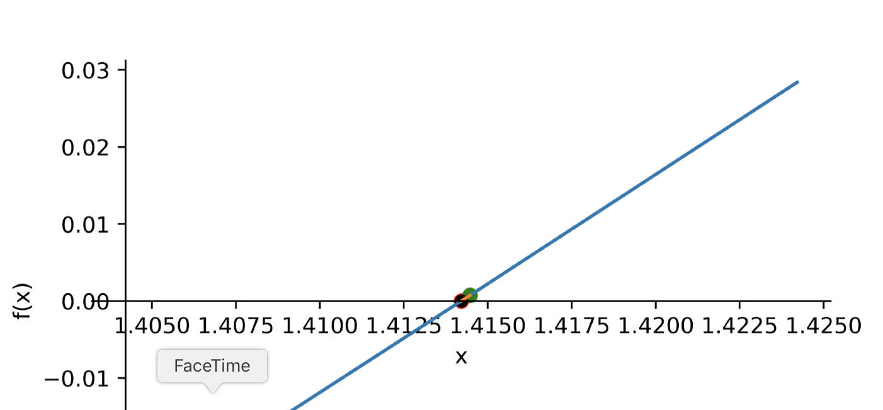
Newton Raphson Iteration 4

Slide 13
MultiVariate Calculus Motivation

Slide 14
Multivariate Calculus - Power Rule
https://youtu.be/S0_qX4VJhMQ

Slide 15
Mulrivariate Calculus - Chain rule
https://youtu.be/YG15m2VwSjA?t=540

Slide 16
Directional derivatives and Steepest Strategies

Slide 17
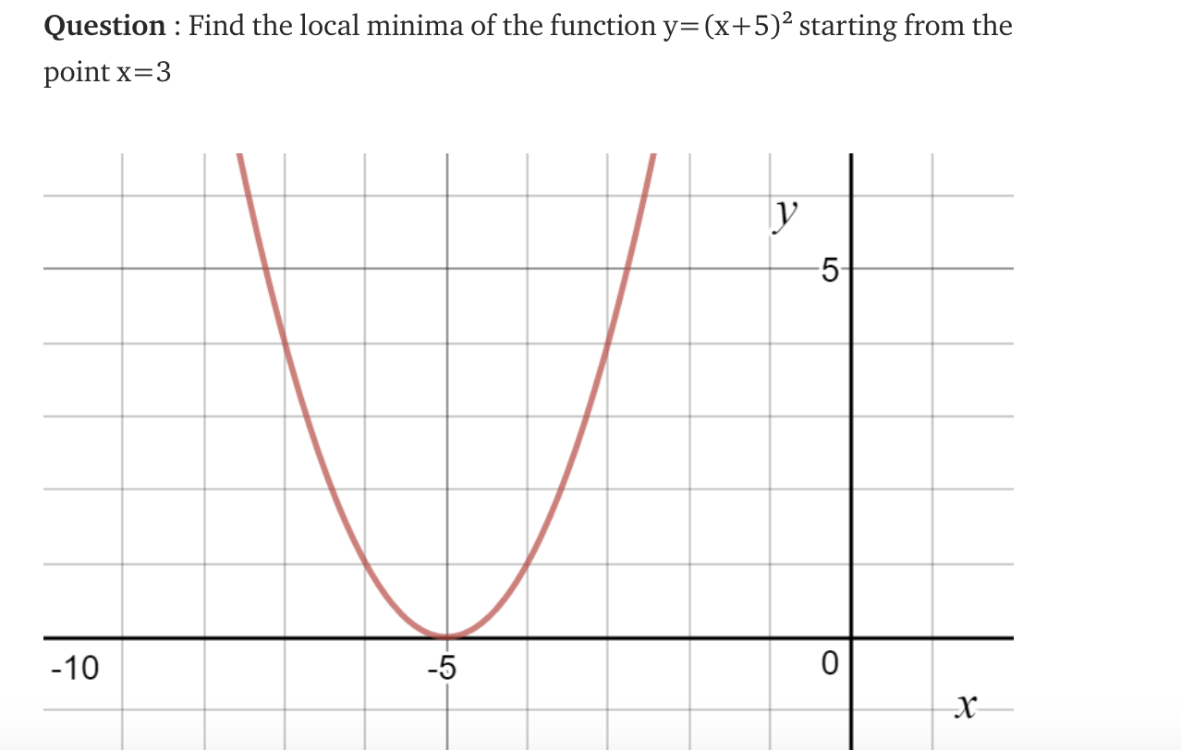
Gradient Descent

Slide 18
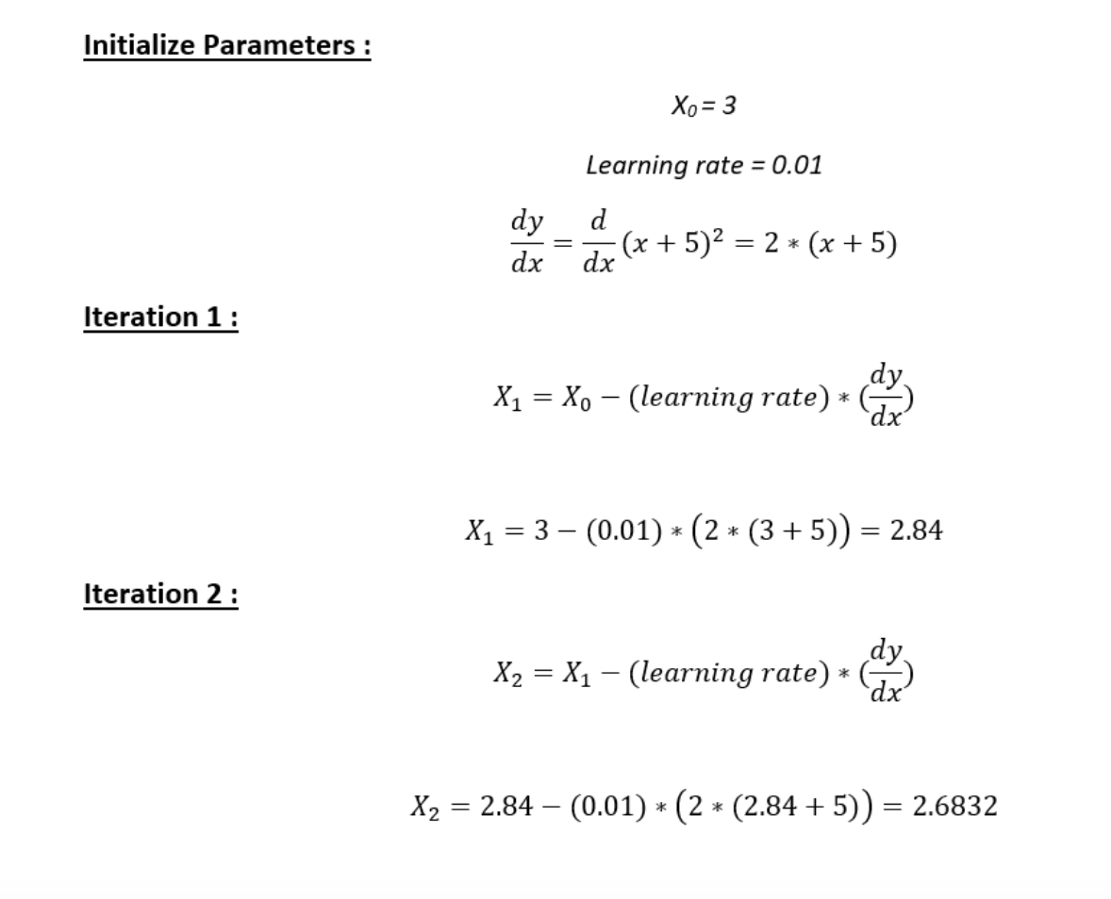
Steps for GradientDescent

Slide 19
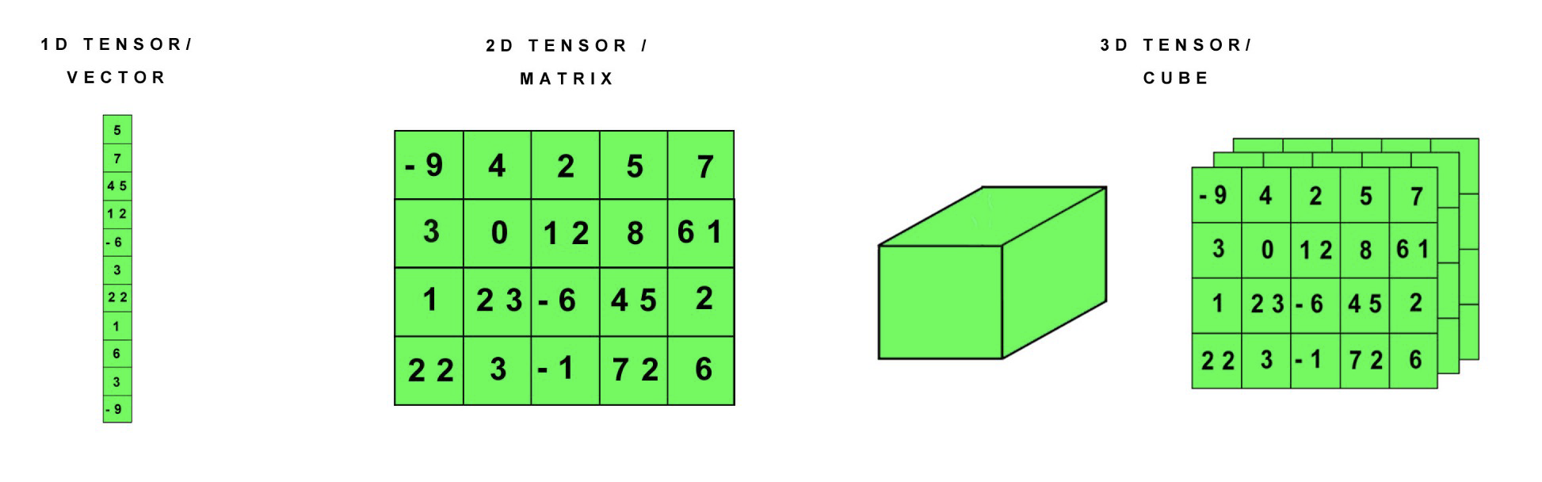
Tensors

Slide 20
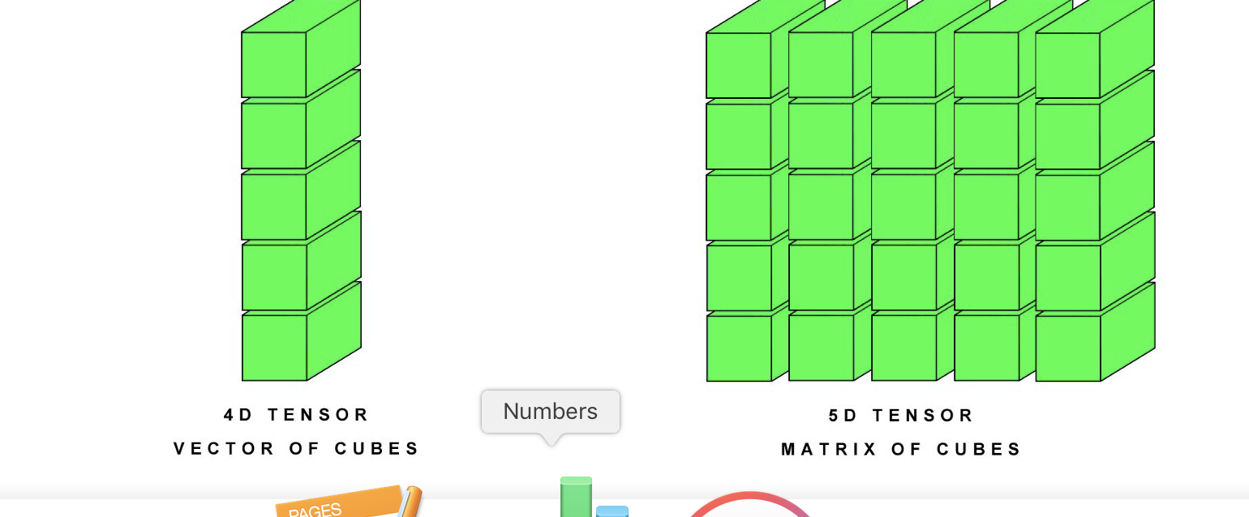
Higher rank tensors

Slide 21
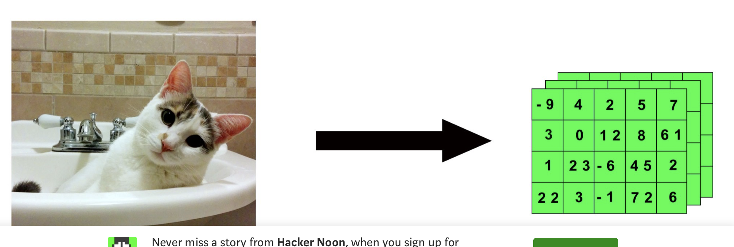
Image representation

Slide 22
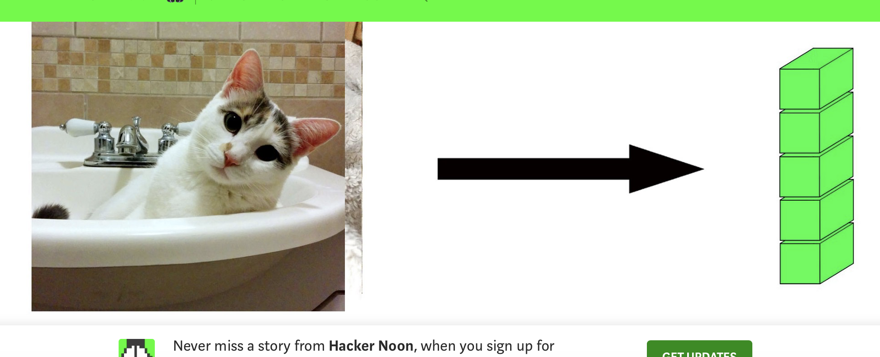
Movie as a 4D tensor

Slide 23
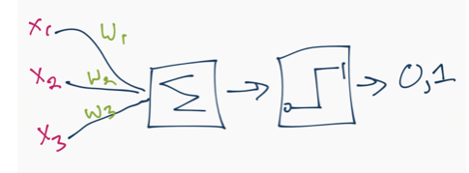
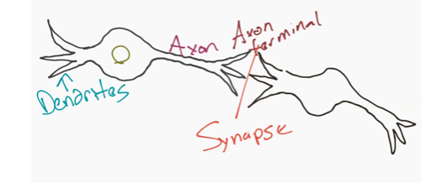
Neural Network Sample

Slide 24
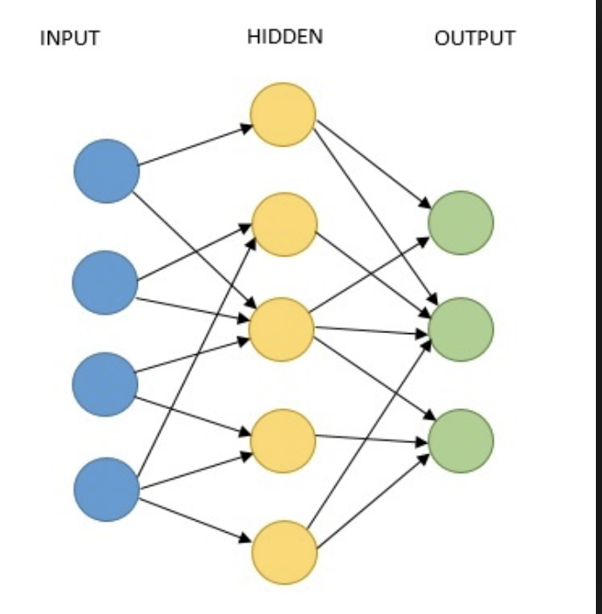
Back propogation

Slide 25
Lagrange Multipliers

Slide 26
Statistics of datasets

Slide 27
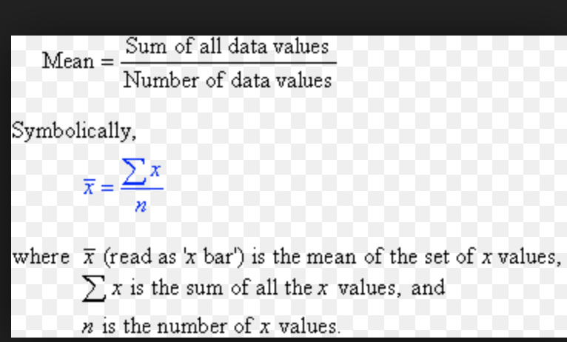
Mean of a dataset

Slide 28
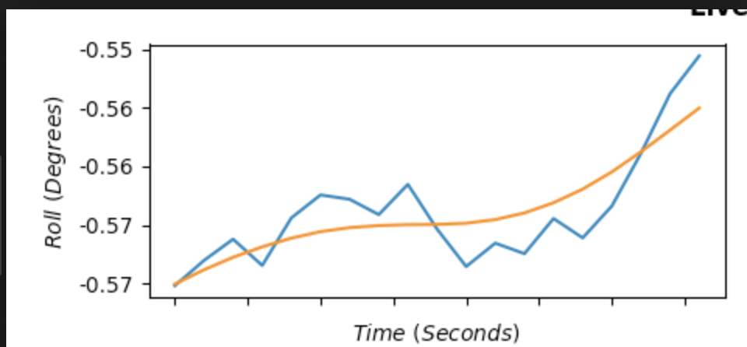
Variance of a dataset

Slide 29
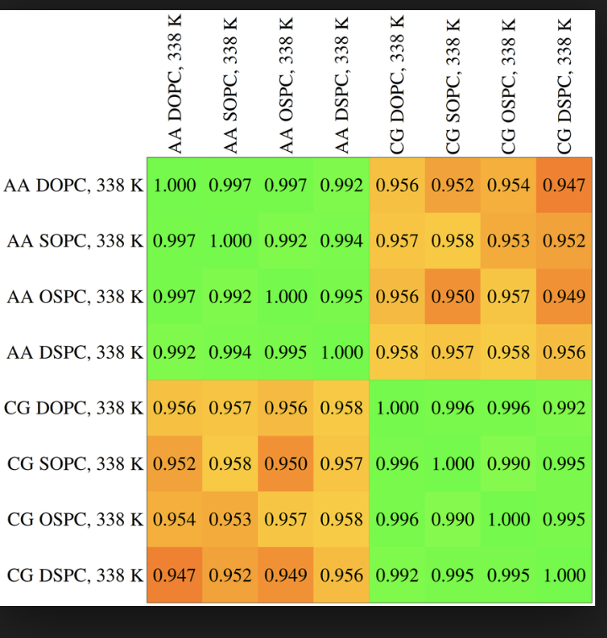
Covariance

Slide 30
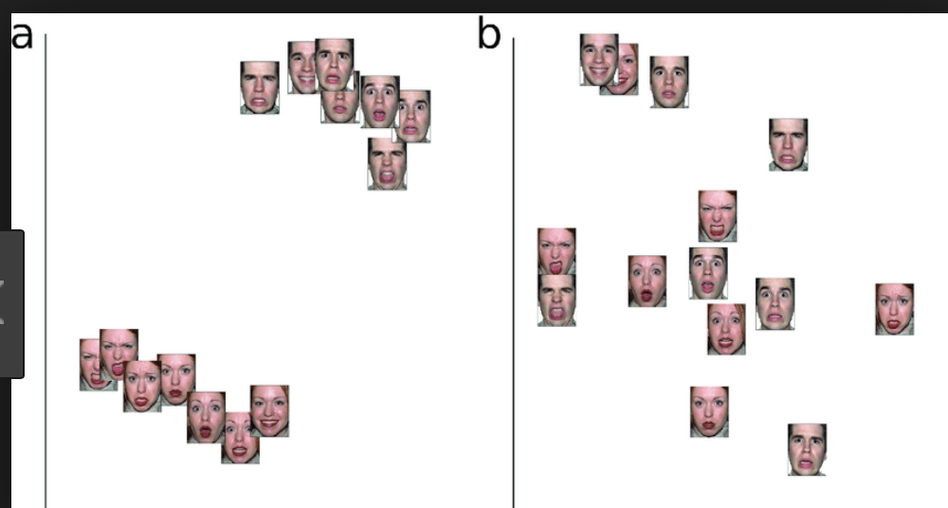
Clustering

Slide 31
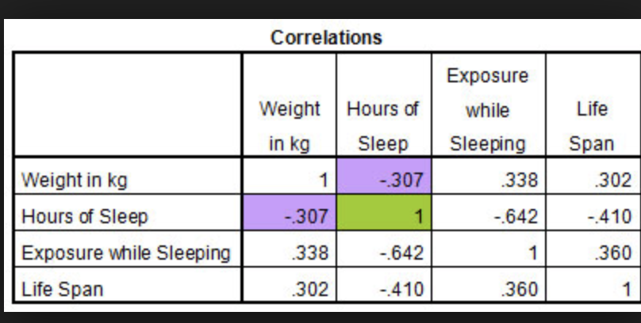
Covariance Matrix

Slide 32
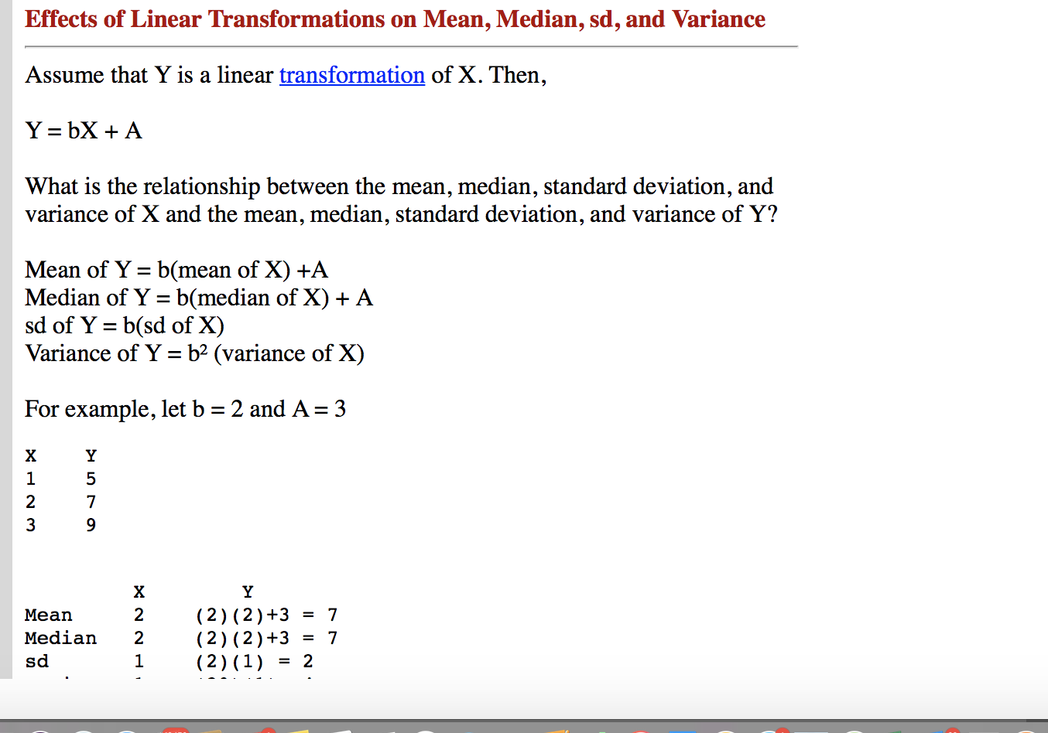
Effect on mean and variance

Slide 33
Probability

Slide 34
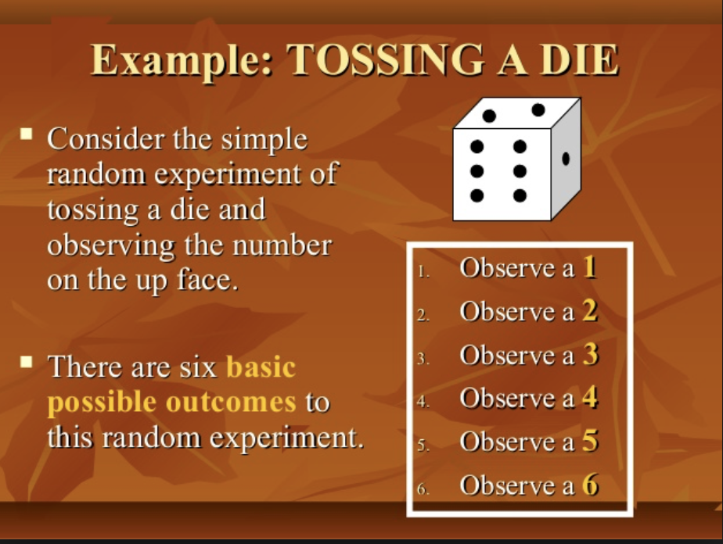
Probability – Random Experiment

Slide 35
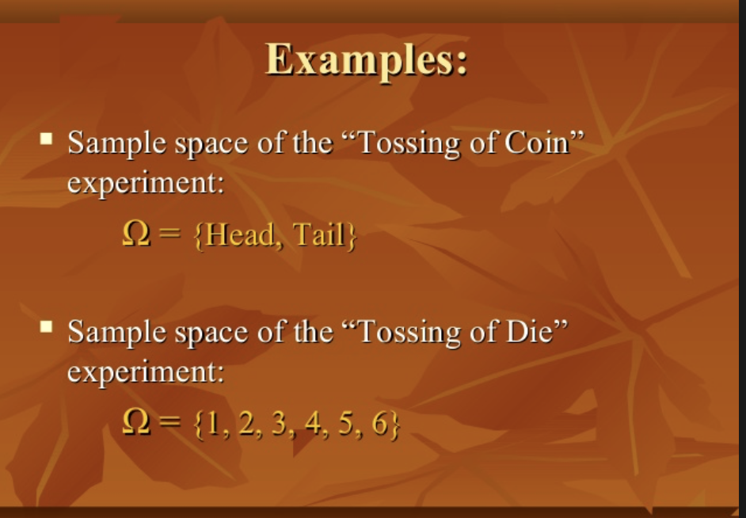
Sample space

Slide 36
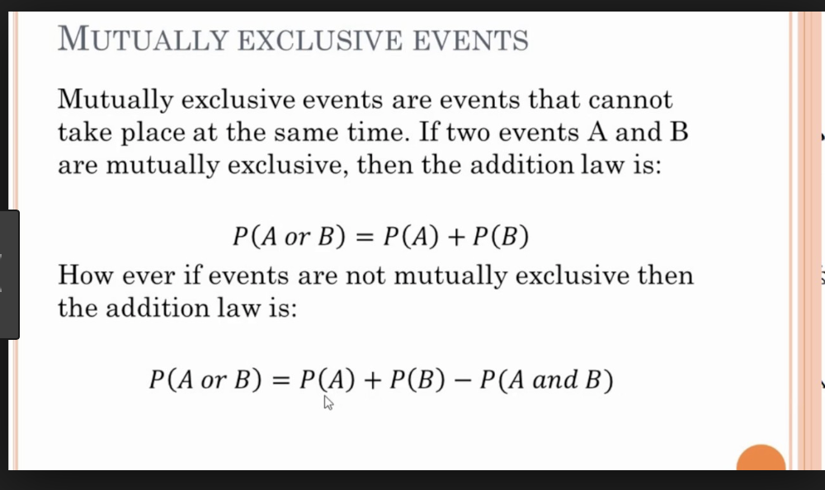
Types of events

Slide 37
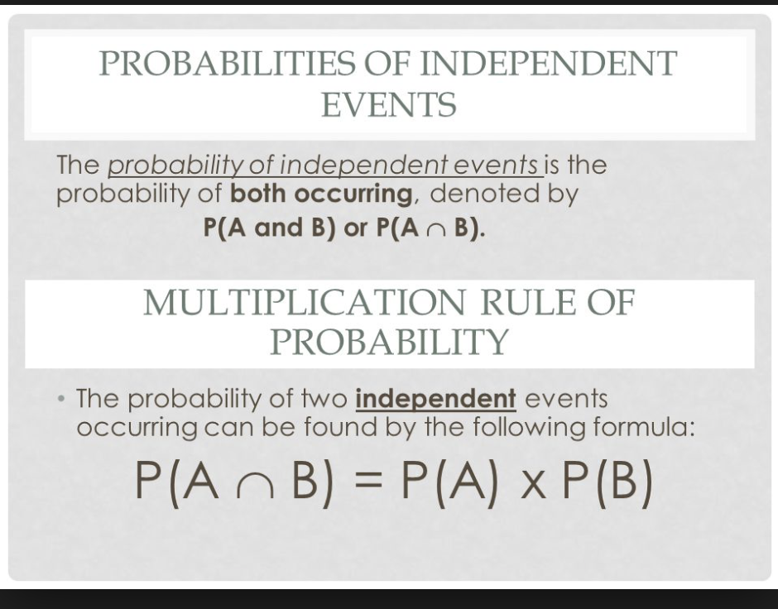
Independent Events

Slide 38
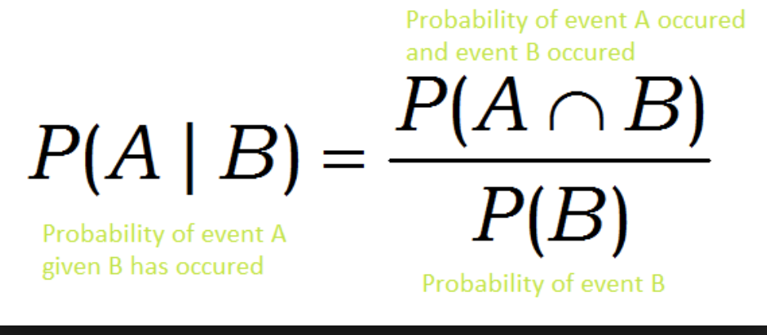
Conditional Probability

Slide 39
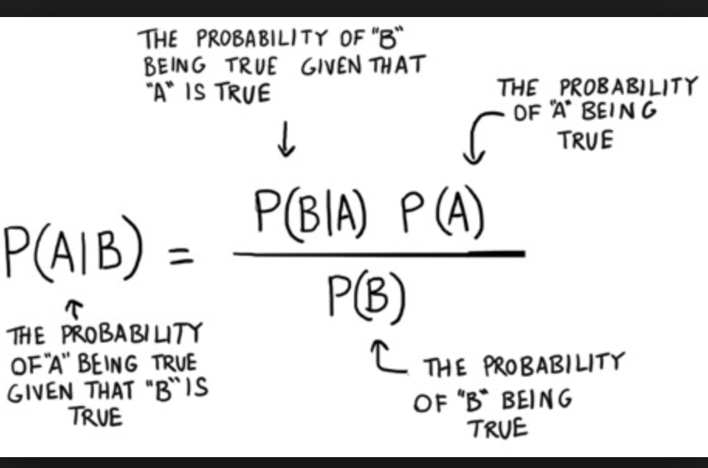
Bayes Theorem

Slide 40
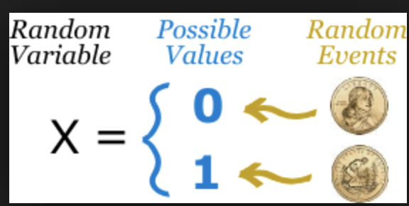
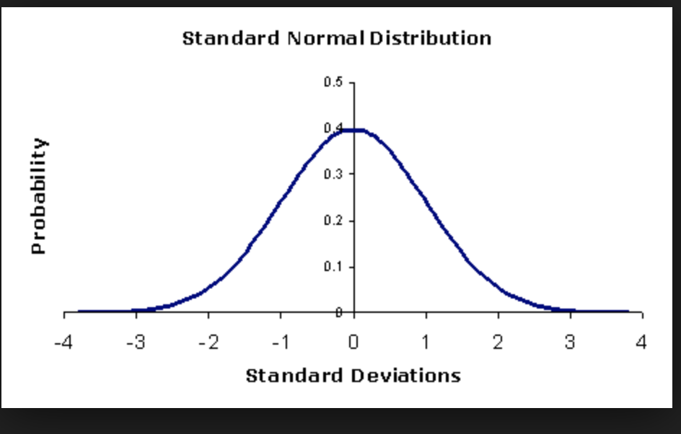
Random Variable

Slide 41
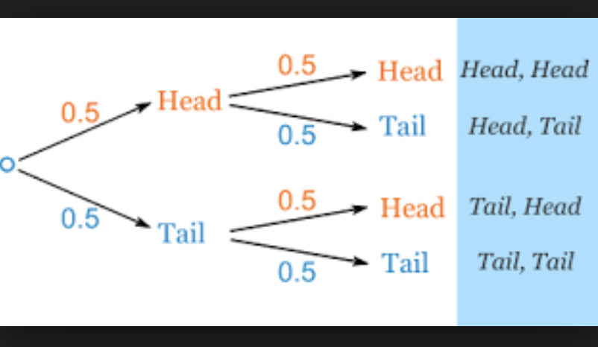
Probability trees

Slide 42
Bayesian inference

Slide 43
Probability distribution

Slide 44
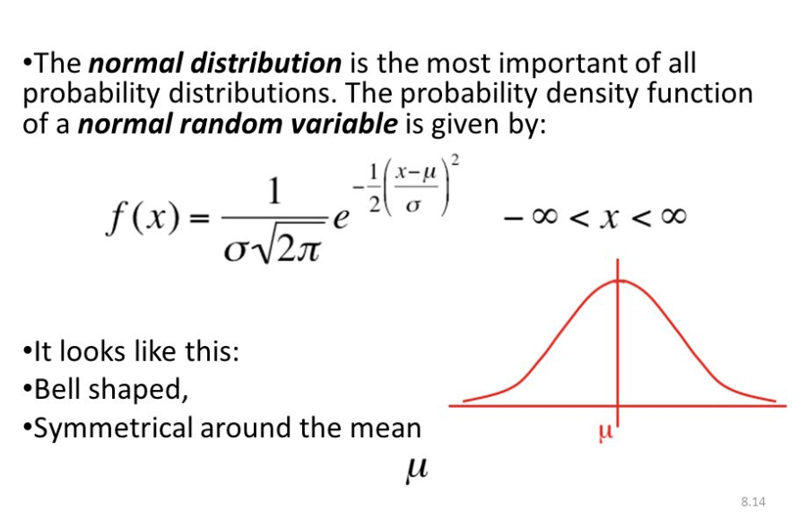
Normal Distribution

Slide 45
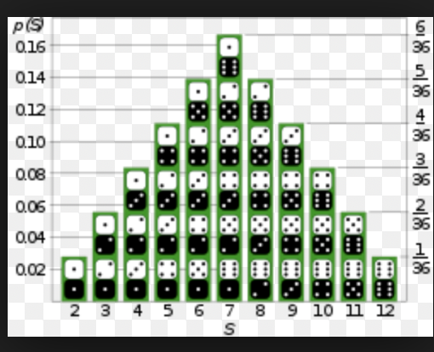
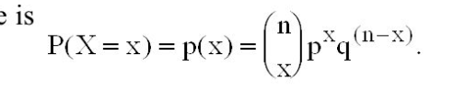
Probability Distribution

Slide 46
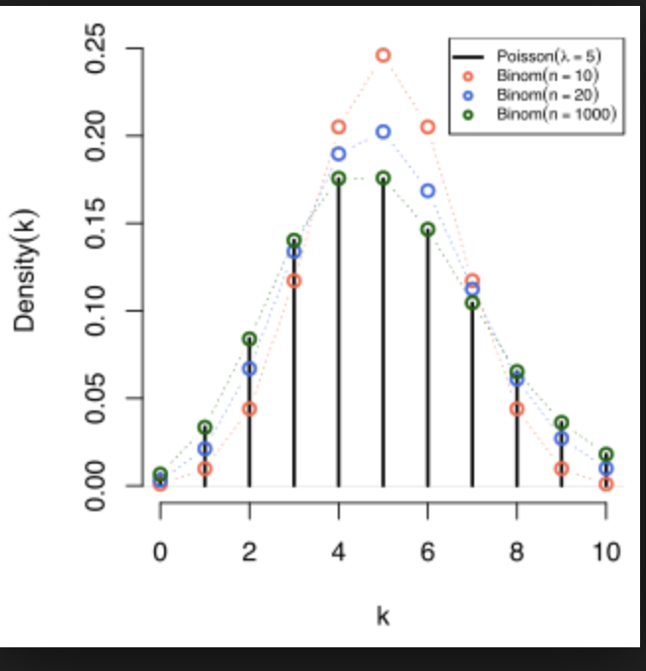
Poisson Distribution Graph

Slide 47
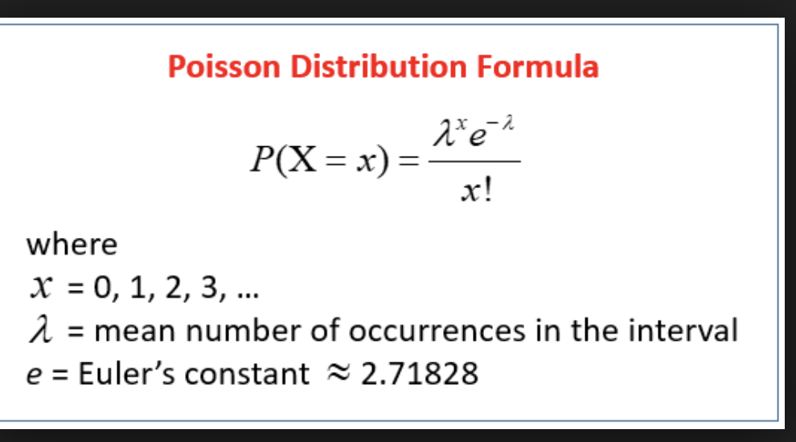
Poisson Distribution

Slide 48
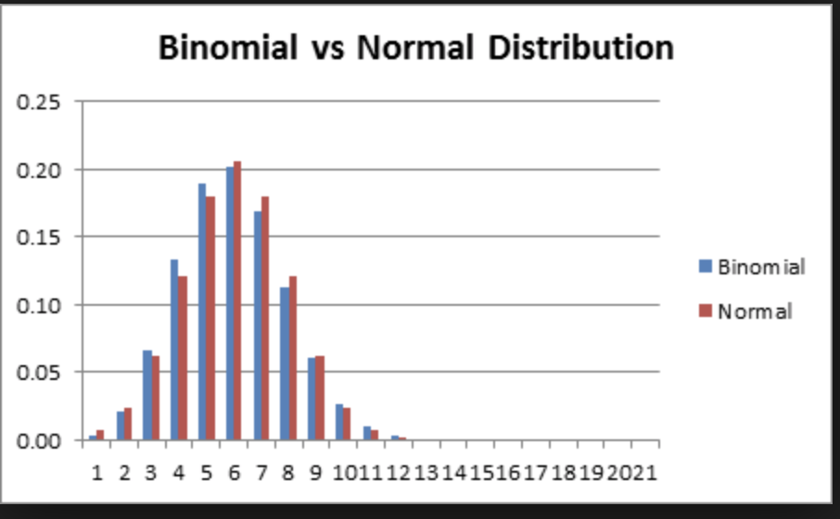
Normal approximation to Binomial

Slide 49
Statistics

Slide 50
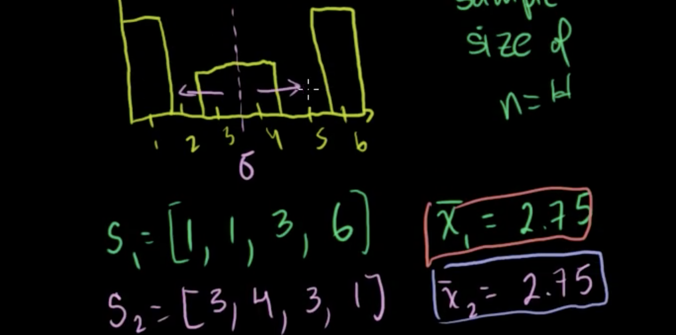
Central Lim it Theorem

Slide 51
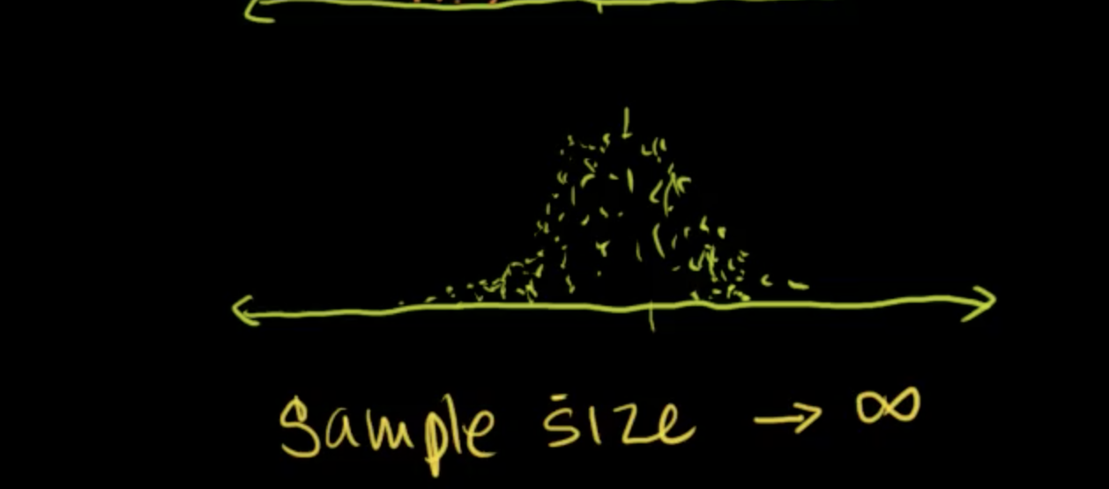
Central Limit Theorem

Slide 52
Variability and Central limit theorem
https://www.youtube.com/watch?v=sNWMYEGgY8c

Slide 53
Statistical SIgnificance
https://youtu.be/jLFeqQxGtOc

Slide 54
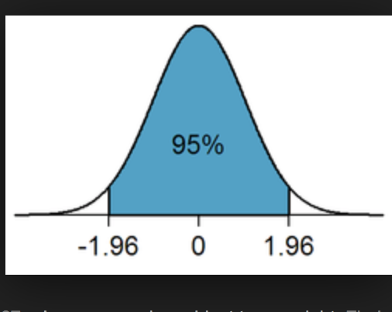
Statistical Significance

Slide 55
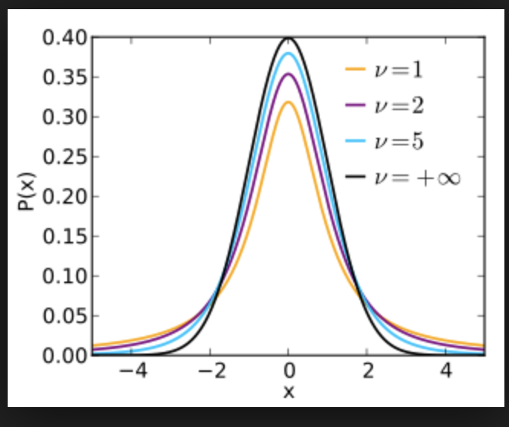
Statistical Significance t-Distribution

Slide 56
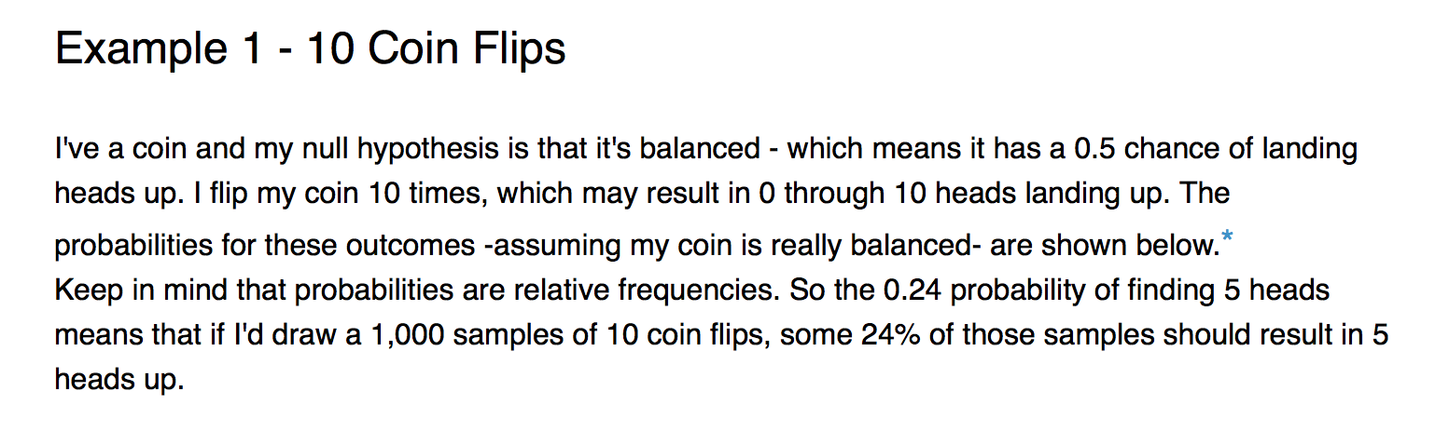
Hypothesis testing

Slide 57
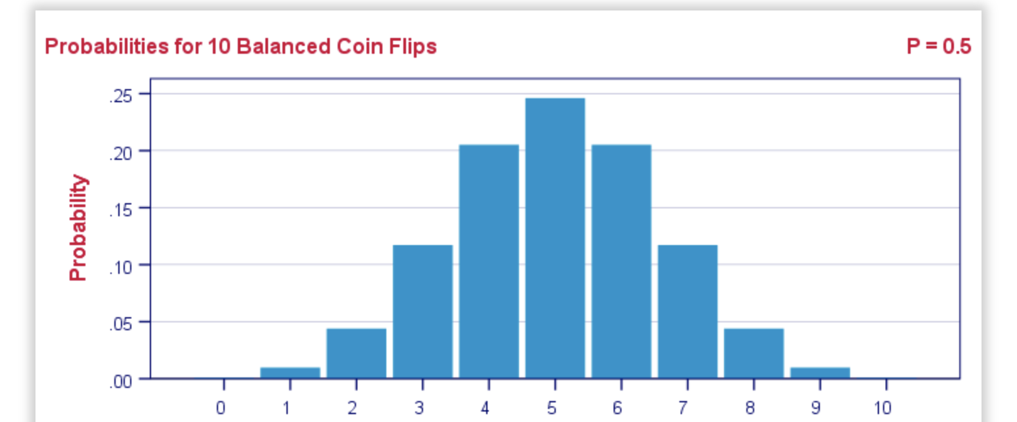
Probabilities

Slide 58
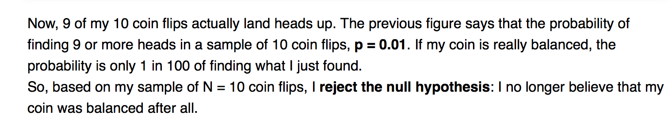

Slide 59
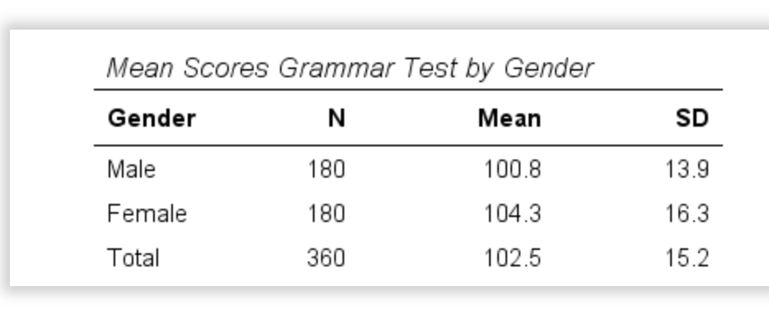
Sample

Slide 60
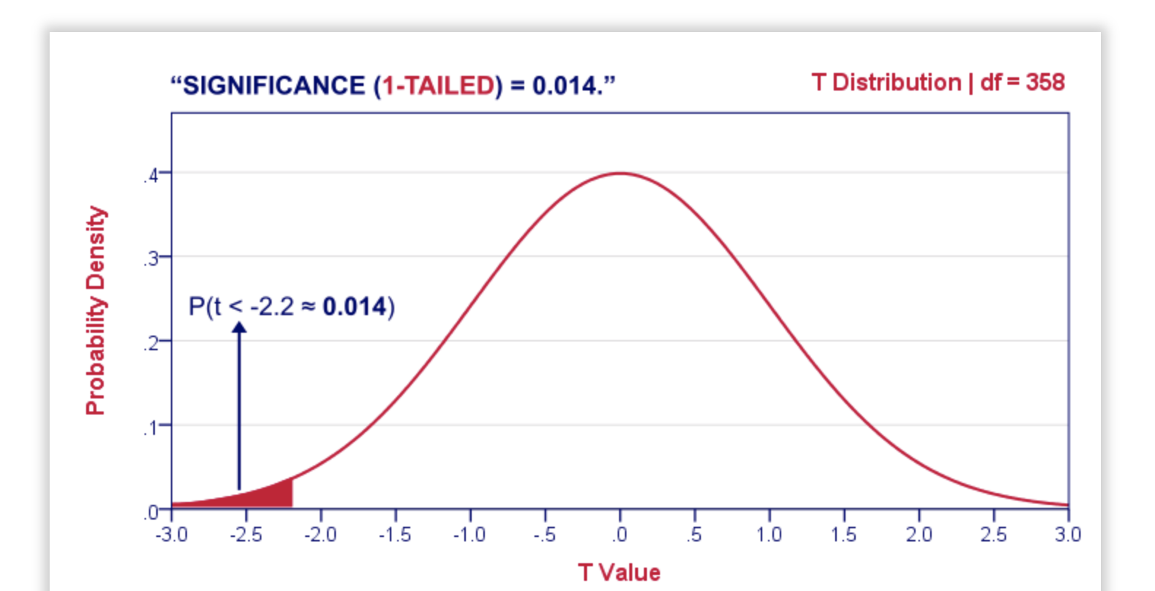
Right Tail Significance

Slide 61
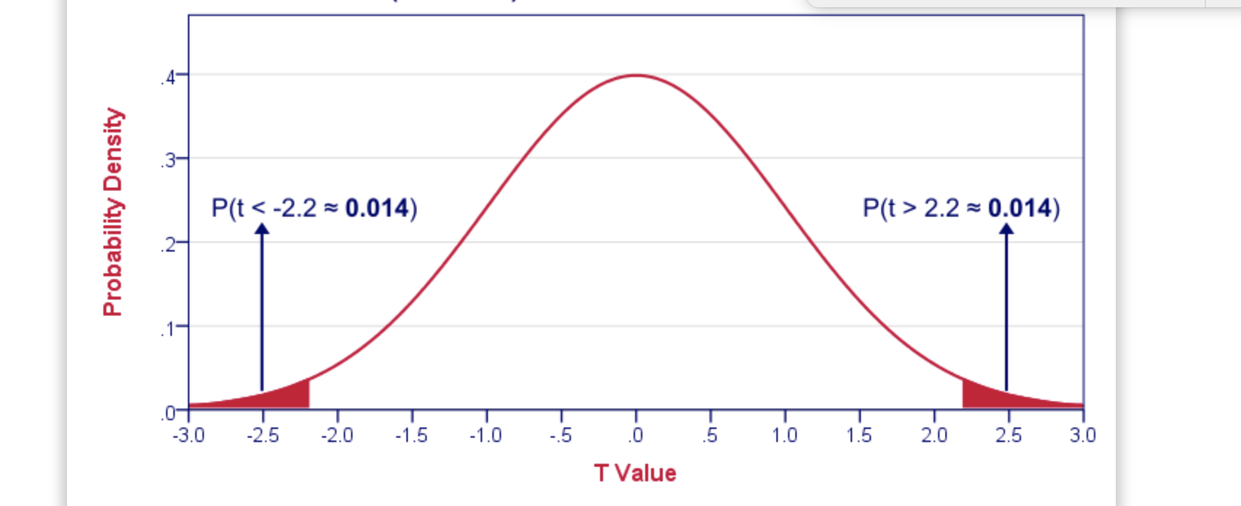
2 Tailed significance

Slide 62
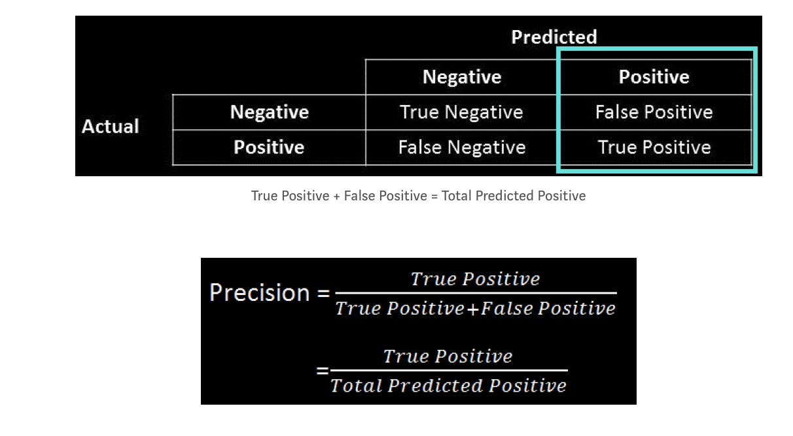
ACCURACY VS PRECISION

Slide 63

Recall

Slide 64

Confidence Interval example

Slide 65

Confidence Interval

Slide 66

Decision Errors

Slide 67

Practical SIgnificance

